Slide 1
OES Unit 3 (and 4) 2015

Slide 2
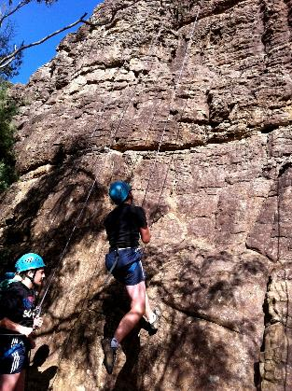
What We’ll Cover…
Navigating your best friend:
VCAA & the Study Design
SACS and exams for the year
Practical Work
Organising Yourself
Unit 3 – Intro to main ideas
How do I use “Learning Intentions”???
Holiday Homework

Slide 3
Quick Reality Check!
THIS IS A UNIT 3 / 4 SUBJECT…EVERTHING COUNTS!!
At least 2 SAC tasks per unit (total 50%); Final Exam (50%)
If you want feedback, YOU need to take initiative
If you want to do your best, EMPOWER yourself and KNOW THE STUDY DESIGN!

Slide 4
VCAA & the study design
Your BEST FRIEND:
www.vcaa.vic.edu.au
Let’s get a copy of that study design and take a peek…

Slide 5
1. Australian Landscape BEFORE Humans

Slide 6
Learning Intentions…What???
To be able to describe the characteristics of the Australian Environment before humans
To be able to describe the break up of Australia from Gondwana over time, and know the role of continental drift
To be able to describe the adaptions of a plant or animal to survive in the Australian environment
To be able to describe the role that biological isolation, geological stability and climatic variations has played in the uniqueness of Australia’s flora and fauna

Slide 7
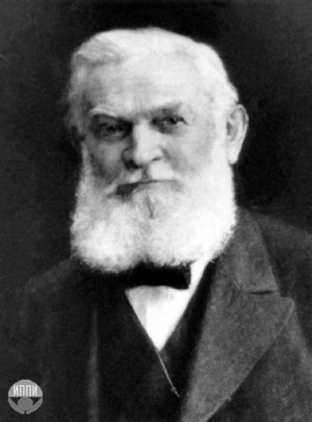
Our origin
Everybody knows the earth has been developing and changing over the past 2 billion years. And even as recent as 200 million years ago, the earth was a remarkably different place.
The Dude Who Changed it All:
It wasn’t until 1912 that meteorologist
Alfred Wegener hypothesized that the seven
continents had once been joined
as a supercontinent.

Slide 8
Introducing: PANGAEA!
250 million years ago, this is how the world map looked…

Slide 9
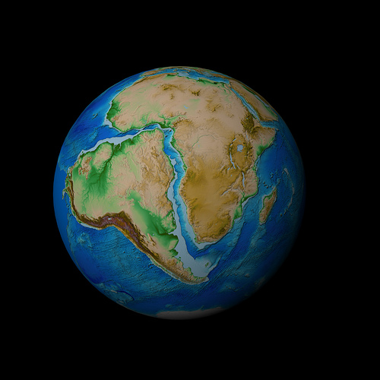
The Evidence For Pangaea’s existence:
Wegener noticed that the borders of the continent matched up and fit together, almost like a giant jigsaw puzzle.
Matching rocks and fossils were found in countries separated by oceans and tropical plant fossils were found in polar regions and vice versa.
CONCLUSION:
The continents may not have always
been in their current positions

Slide 10
Wegener called the supercontinent Pangaea, meaning "all lands" in Greek, and he said it was bordered by Panthalassa, the universal sea.
He claimed the lands separated 250 million years ago by the process of continental drift, which means the continents just slowly fractured and went their separate ways.
Gondwanaland has been separate from the northern landmasses for around 200MY.

Slide 11
Make a timeline…

Slide 12
Future world?!?

Slide 13
How is this possible?
The Earth’s crust is not one single “chunk” but exists as a series of "tectonic plates” that SLOWLY but CONSTANTLY move/drift.
Like a giant jigsaw puzzle!
The Australian plate drifts ~7cm/year: this is about the same rate as your fingernails grow!

Slide 14
There are 15 major plates… What do you notice?

Slide 15
Jigsaw Challenge!
In pairs, fit the jigsaw of tectonic plates together and glue it on to the blank sheet – the first accurate finishing team attempt will win a prize!

Slide 16
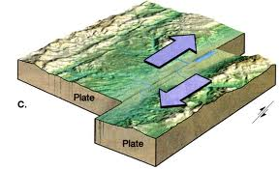
Moving plates
The San Andreas fault in California is an example of a transform plate boundary – the American plate & Pacific plate are sliding past each other. When plates get stuck, pressure builds and is released as earthquakes

Slide 17
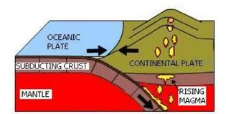
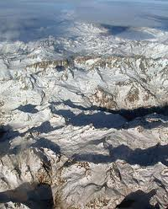
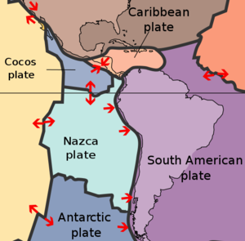
When plates collide…
One plate is forced under the other in what is called a ‘subduction zone’. The Nazca plate is being forced under the South American plate, resulting in the formation of the Andes. Many peaks in the Andes are volcanically active.
THINK: Do we have active
volcanoes in OZ???

Slide 18
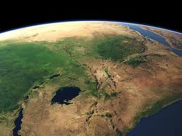
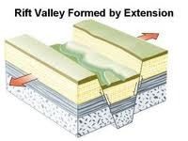
When plates move apart
New crust forms from molten material that rises up when plates move apart. Divergent plate boundaries are responsible for rift valleys and new ocean floors and mid ocean islands. The great rift valley of East Africa is a young divergent plate.

Slide 19
DO NOW – Knowledge check
What was “Pangaea”
Outline what “continental drift” is and what has caused it.
Why is Australia considered to be a “stable” continent?

Slide 20
Quick Review - Gondwanaland
Formed when Pangaea separated it split into Laurasia and Gondwana around 200million years ago
Includes most of the land masses of the Southern Hemisphere – Antarctica, South America, Africa, Madagascar, Australia, New Guinea, New Zealand, Indian subcontinent.

Slide 21
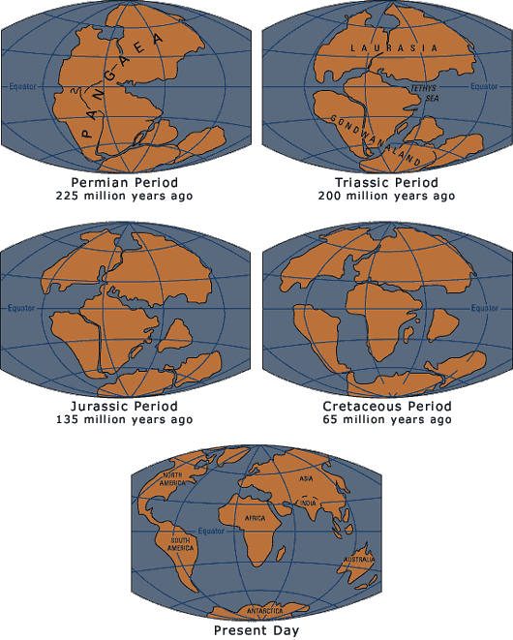

Slide 22
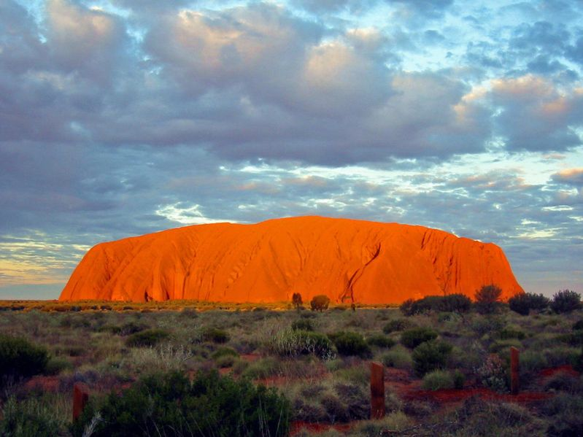
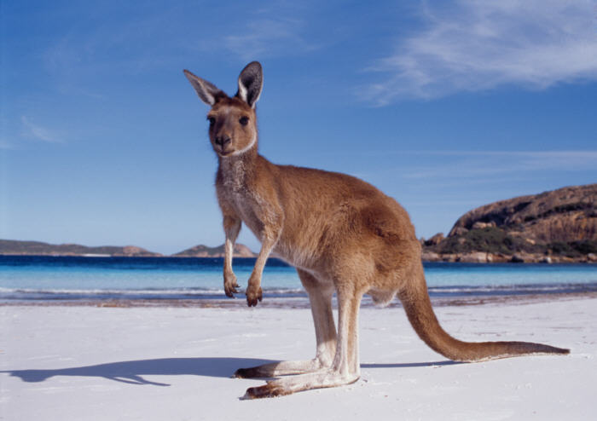
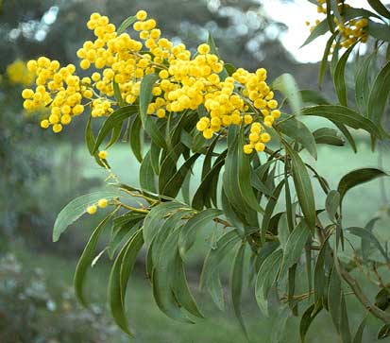
So what has shaped Australia to make it the unique continent it is today?
Unique Geography
Unique Fauna
Unique Flora

Slide 23
Stick in the Map of OZ and:
Annotate the following set of notes onto your map
Leave space to draw geographical features and climatic conditions in different regions
Include examples of uniquely adapted Australian flora and fauna

Slide 24
Factors that have caused Australia to be Unique
The uniqueness of Australia has been shaped by three main factors:
Biological isolation
Geological stability
An erratic climate

Slide 25
Unique Australia
Australia is considered to be one of 12 “megadiverse” countries – these contain 75% of the Earth’s total biodiversity
In Oz, more that 80% are endemic
There are 7 families of mammals endemic to Oz
About 85 per cent of flowering plants, 84 per cent of mammals and more than 45 per cent of birds are unique to Australia.

Slide 26
Why is Australia so unique?
Biological Isolation – refers to the amount of time that Australia has been separated from other continents. Flora and fauna have been able to evolve in isolation.
Geological Stability - Australia has experienced very few earthquakes, development of low mountains ranges. Volcanoes are stabilised (inactive), no existing glaciers, therefore no new nutrients provided for the soil.
Erratic Climate -Australia is the driest continent on Earth. Its climate is very erratic, often moving from one extreme directly to the other (El Nino – extreme climate).

Slide 27
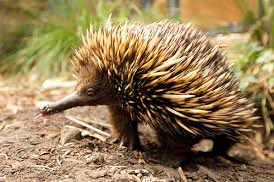
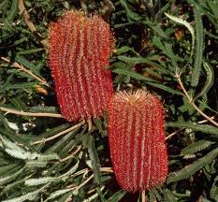
Biological Isolation
Millions of years (approx. how long?) of isolation from other continents have resulted in Australia’s plants and animals evolving very differently to other places
Of the 1350 species of Acacias in the world, 1000 found here
This has also contributed to the high number of endemic species found in Australia.

Slide 28
Biological Isolation
Many of these species have been found to be closely related to other species found around the world through the research of fossils (eg water rats in England – Platypus)
This also meant that due to the lack of predators from Laurasian continents that the mammals that we see today were able to flourish

Slide 29
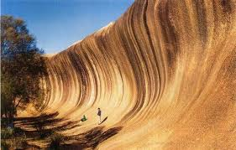
Geological stability
The Australian continent hasn’t changed, other than eroded, since the uplift of the Great Dividing Range 80 million years ago.
This geological stability has given erosion a lot of time to expose some of the world's oldest and most amazing rock formations, like the 12 Apostles.
Geological stability is a characteristic that has resulted in only relatively minor change to Australia's geological substrates and many of its landscapes over extremely long periods of time.

Slide 30
Geological stability
Where there is no geological activity, there is no formation of new fertile soils, instead the old soil is leached and blown away, leaving plants with little chance to fasten their roots.
These soil conditions have forced plants to develop unique adaptations to balance on a bare rock wall or develop long roots to survive in a lifeless desert.
This geological stability has meant that Australia is relatively flat, has very few earthquakes etc.

Slide 31
Flat landscapes are prone to…?
Bushfires
How has this shaped our flora and fauna?
Floods
How has this shaped our flora and fauna?

Slide 32
Climatic variations
Australia is the second driest continent on Earth. Its climate is very erratic, often moving from one extreme directly to the other. It can have long years of drought that is broken by devastating floods.
The very flatness of the majority of the continent turns out to be of importance to the survival of many plants and animals

Slide 33
El Nino and La Nina
Which phenomenon does Australia experience most often?
How does this influence our climate?
https://www.youtube.com/watch?v=yCsMmajLYG4

Slide 34
Climatic variations
The plants and animals of Australia have been very strongly influenced by the climate. Both have adapted to survive, as a species if not always as individuals, in very harsh environments in many parts of the continent.
For example: plants of a particular area may have to cope with poor soils, often low and unpredictable water availability

Slide 35
Learning Activity
Select one flora AND one fauna species endemic to Australia
Investigate the adaptions that have been caused by the three factors (biological isolation, geological stability, climatic variation) we have looked at in this session

Slide 36
Remember that you should be able to
Describe how an environment may have looked like before human habitation (think about how human impacts have changed the environment)
Describe how geological stability, biological isolation and climatic variations have influenced the natural environment, including plants and animals

